Slide 1

Advanced Programming For Business Analytics
Miguel Torrealba Schwarz, Julio Berrocal Alvarez, Nicolas Gonzalez Aguirre, Abdur Rahman

Slide 2
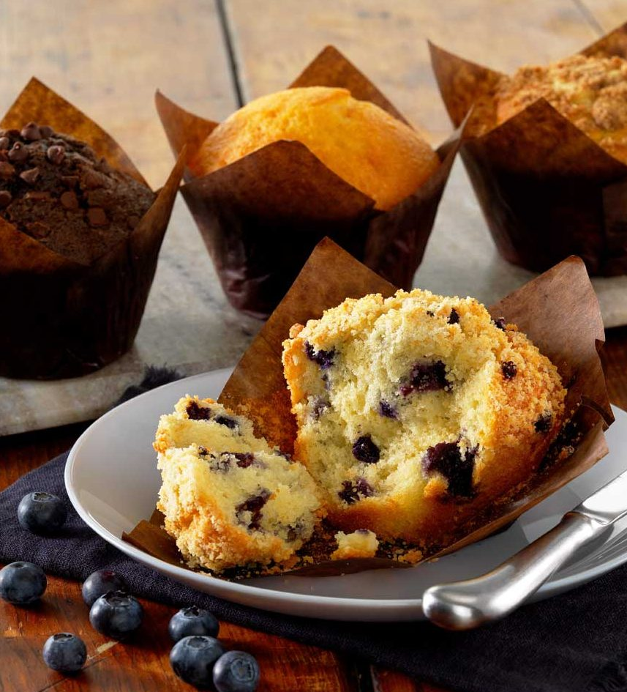
Introduction
Mission: To consistently produce top quality, premium valued bakery products with the taste of hometown goodness in every bite.​
Muffin Town is a leading bakery based in Chelsea, Massachusetts, known for its exceptional baked goods.​
Established in 1978, Muffin Town has grown from a small bakery into a renowned brand recognized for its high-quality products.​
Muffin Town offers a diverse range of baked goods, including muffins, cakes, pastries, and other delicious treats, catering to various tastes and preferences.​
With a nationwide presence, Muffin Town serves both retail consumers and the foodservice industry, providing its products to a wide range of customers across the country.

Slide 3
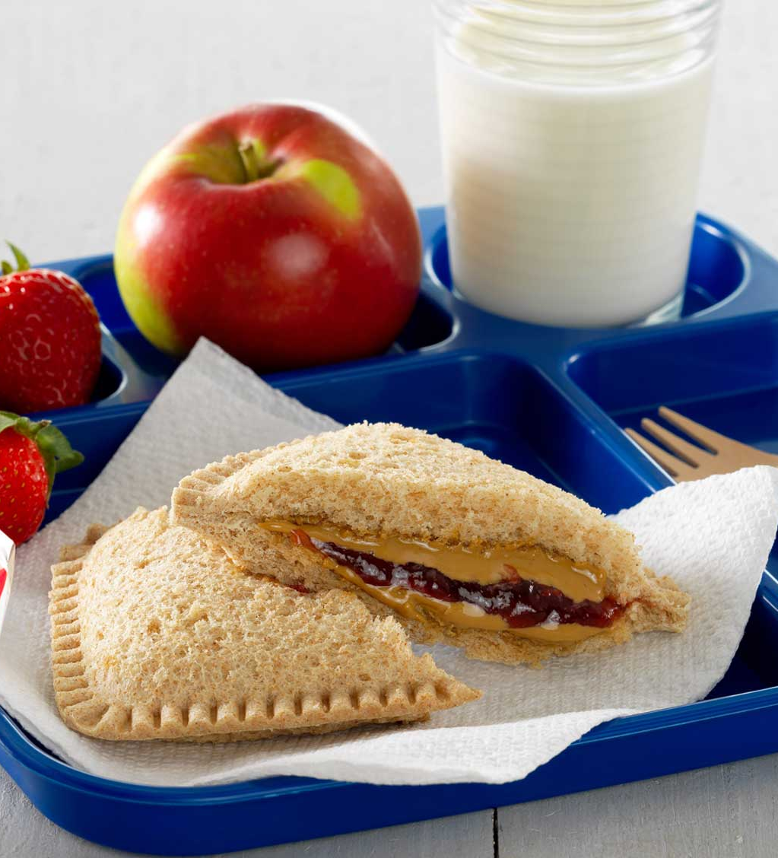
Project Background
Visited Muffin Town's plant in Lawrence to gain insights into their operations and meet with Brian, the key contact.​
Engaged in discussions with Brian to understand his needs and objectives for the project.​
Brian provided Excel files containing data on plant performance for each SKU (Stock Keeping Unit).​
Conducted data cleaning and analysis to prepare the data for further insights.​
Established biweekly meetings with Brian to update him on project progress and gather feedback.​
Developed an Excel template covering the previously shared files and utilized the Gradio library in Python to create a platform for Brian to obtain quick insights on the performance of different plants.​

Slide 4

Input
Muffin Town used several excel sheets to manage the information with no standards on
Formats​
Units of measurement​
Protocol to entry​
Single source of information​
This led to data that did not match with the reality of the business, neither led to valuable insights​
To begin the process of improvement, several conventions were implemented in their process of managing inputs​
Created a single source of information after mapping the process and creating a schema​
Created a Master Data for all SKUs, Production Lines, and capacity​
Created tables to organize information and fed through the primary key​
Validated data through conditional formatting ​
Minimized error and manual input with drop down lists​

Slide 5
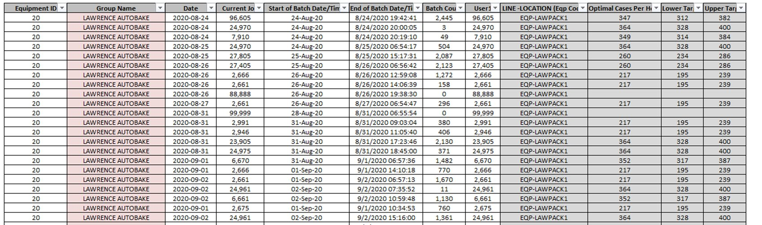
Excel Template
The excel file standard sets the right path for the codes proper run​
Uses color coding to define data type and inputs​
Show flexibility for skus increase and other production parameters

Slide 6
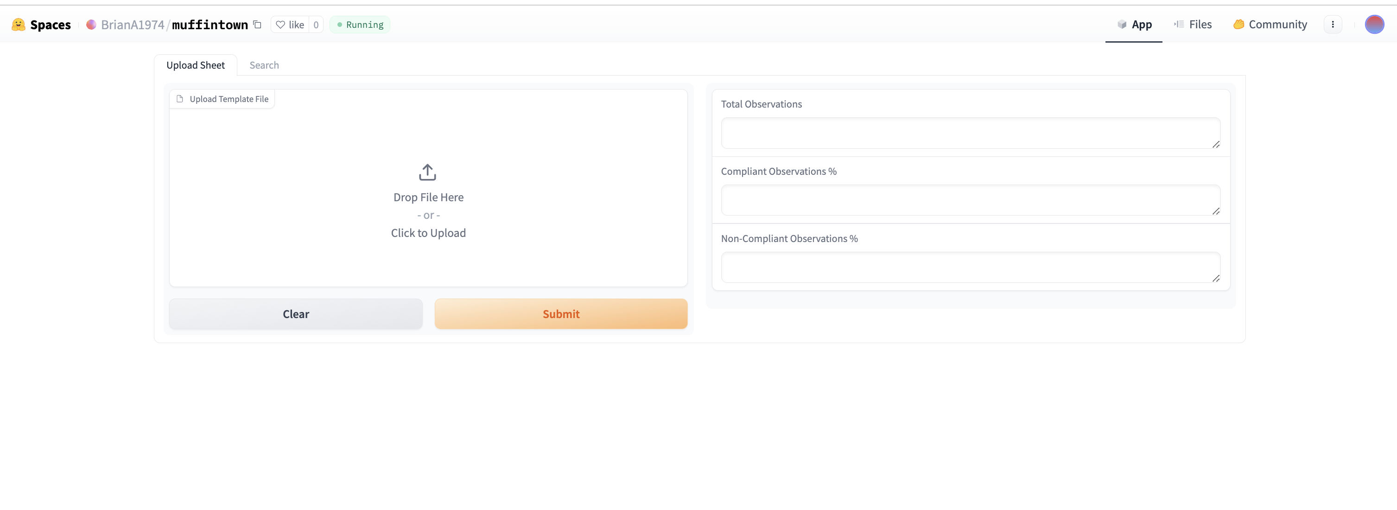
Gradio Layout

Slide 7
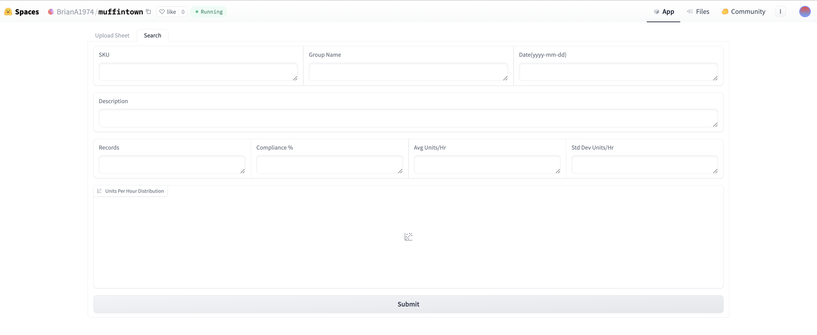
Gradio Layout

Slide 8
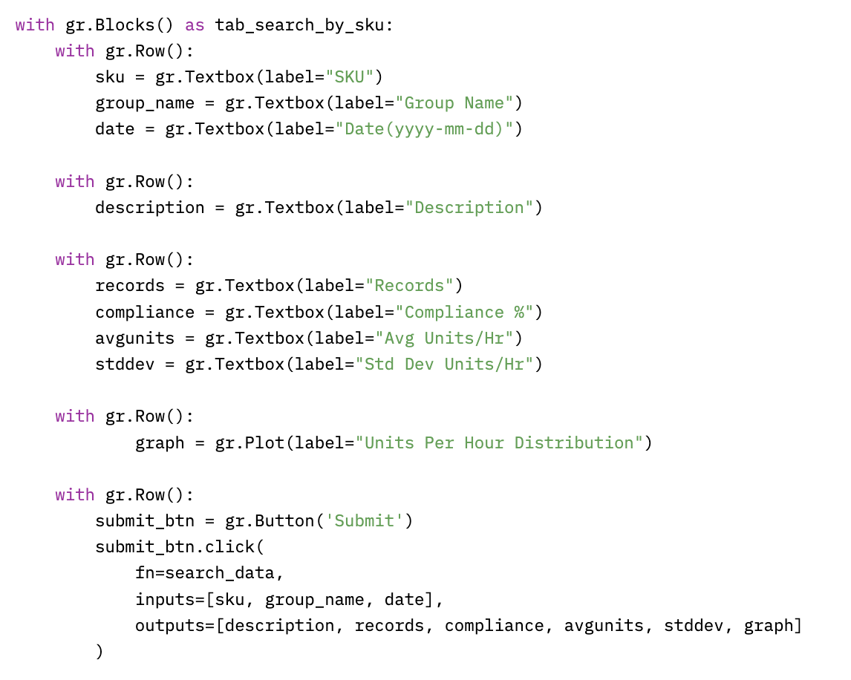
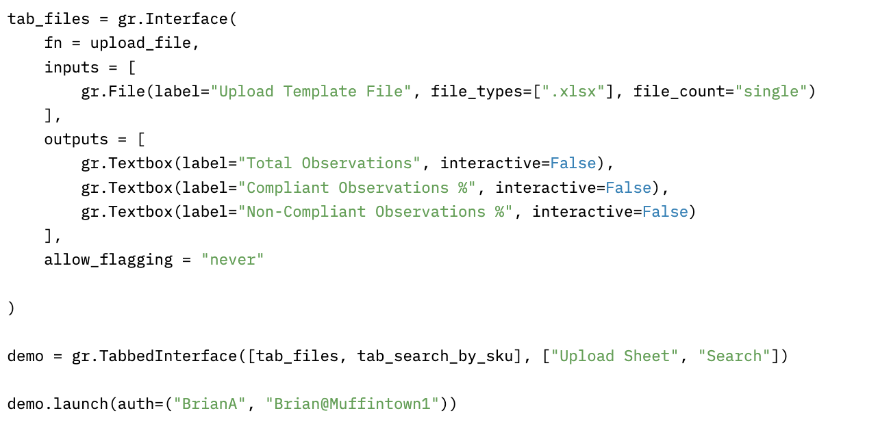
Gradio Layout

Slide 9
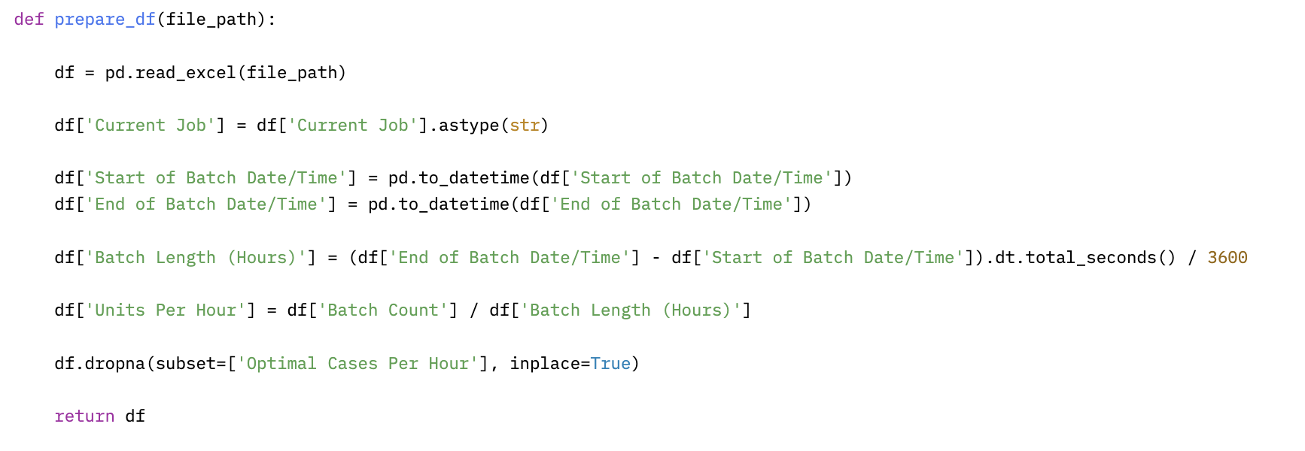
Function prepare_df
Notes:
The function reads an Excel file located at the given file path into a DataFrame using pd.read_excel.​
It converts the 'Current Job' column to strings using .astype(str).​
It converts the 'Start of Batch Date/Time' and 'End of Batch Date/Time' columns to datetime objects using pd.to_datetime.​
It calculates the duration of each batch in hours by taking the difference between 'End of Batch Date/Time' and 'Start of Batch Date/Time', converting it to total seconds, and then dividing by 3600 to get hours.​
It calculates the 'Units Per Hour' by dividing 'Batch Count' by 'Batch Length (Hours)' and stores the result in a new column.​
It drops rows where the 'Optimal Cases Per Hour' column contains missing values using dropna.​
Finally, it returns the modified DataFrame.​

Slide 10
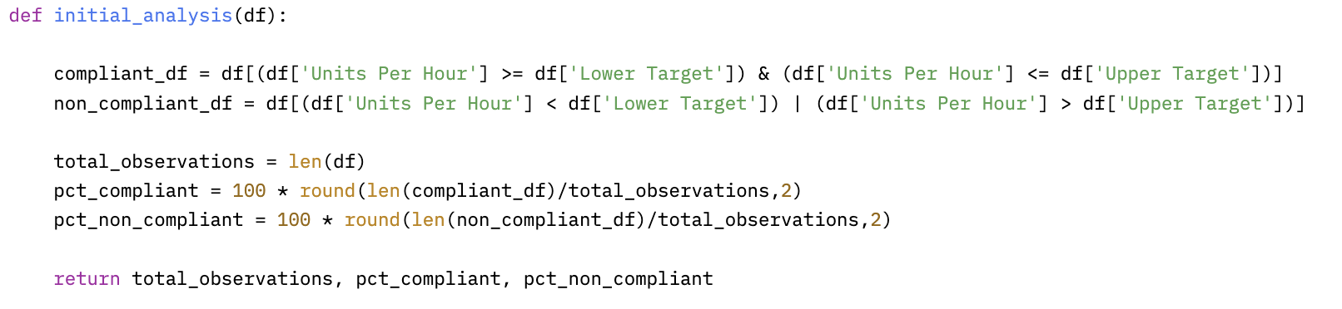
Function initial_analysis
Notes:
Filters the DataFrame `df` to create a new DataFrame `compliant_df` containing rows where the 'Units Per Hour' fall within the range specified by 'Lower Target' and 'Upper Target’. ​
It calculates the total number of observations in the original DataFrame `df` and stores it in the variable `total_observations`.​
It calculates the percentage of observations that are compliant by dividing the length of `compliant_df` by `total_observations`, rounding the result to two decimal places, and multiplying by 100.​
Finally, it returns the `total_observations`, `pct_compliant`, and `pct_non_compliant`.

Slide 11
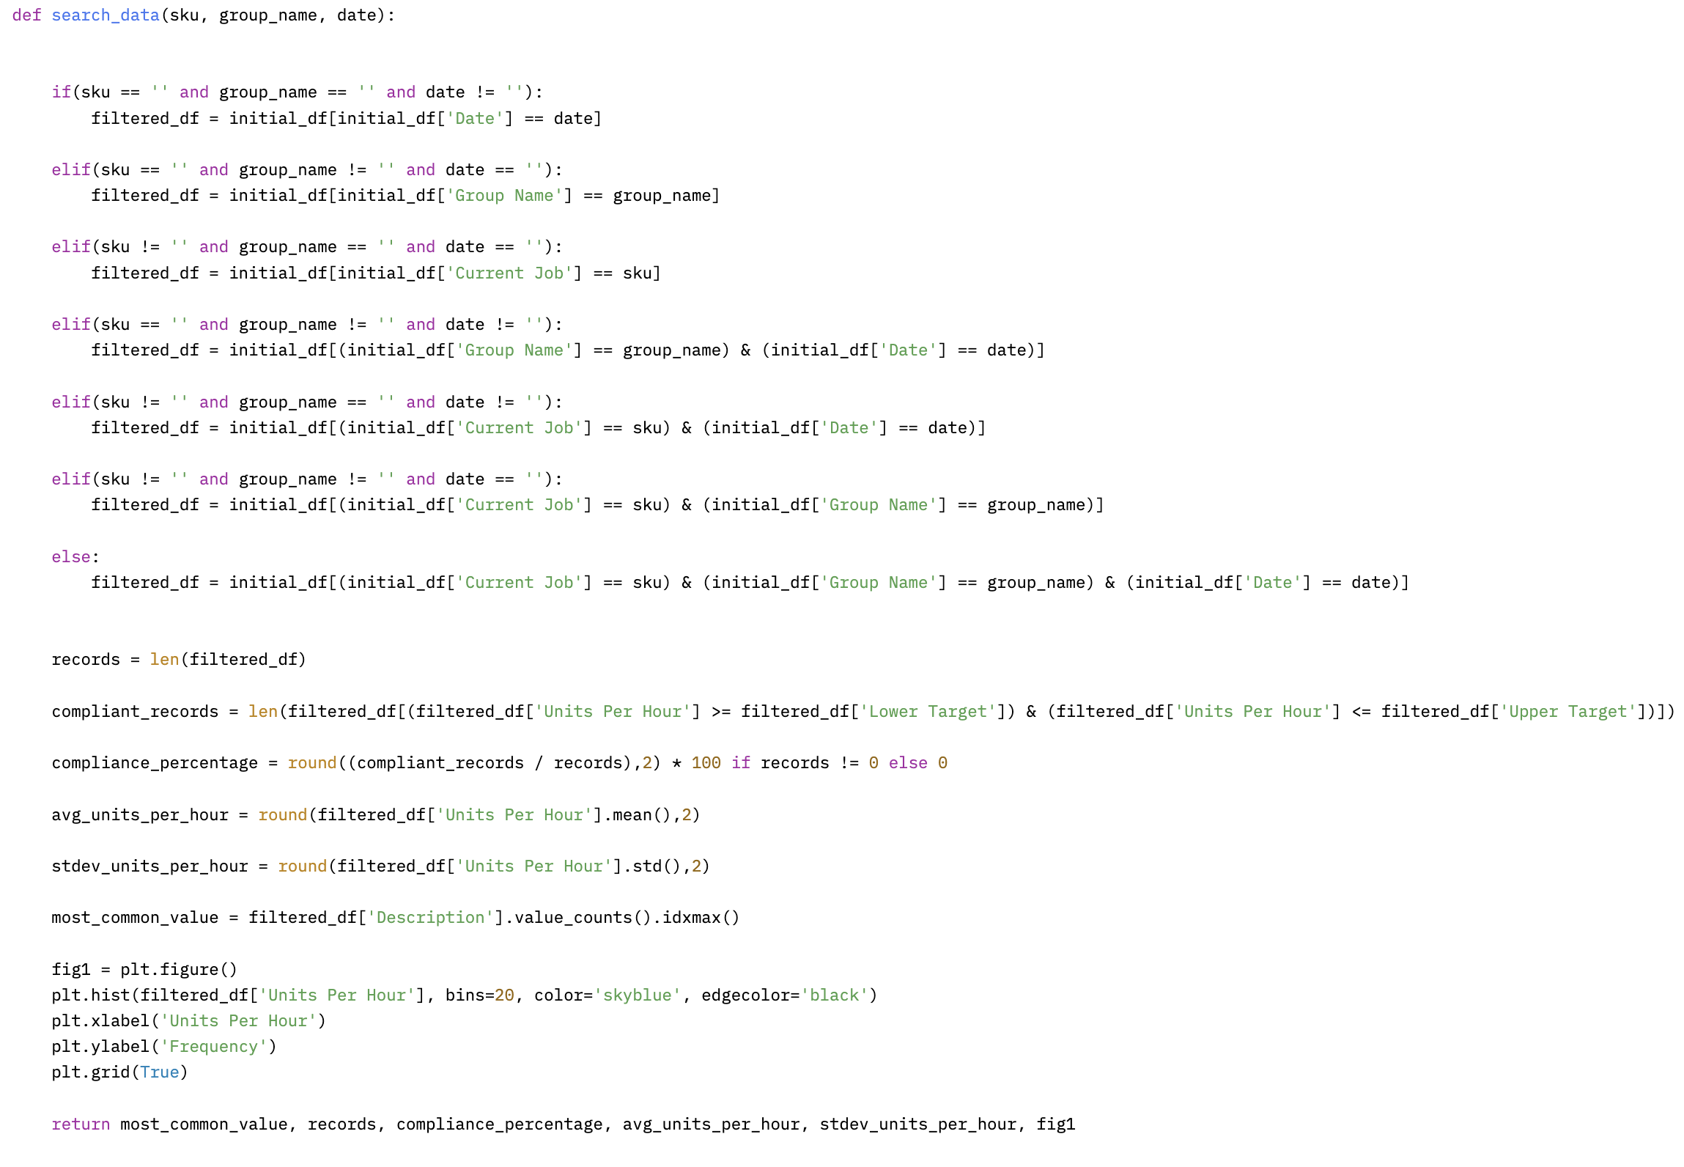
Function search_data

Slide 12
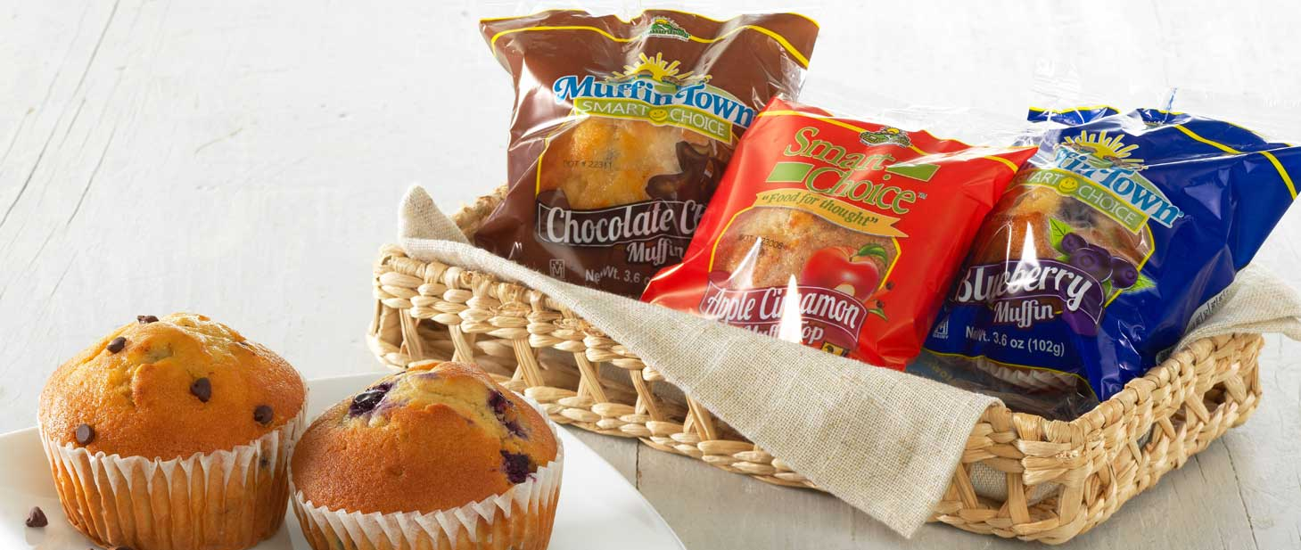
Application Demo
https://huggingface.co/spaces/BrianA1974/muffintown
Notes:
skus = ['96605', '24970’]
group_names = ['LAWRENCE AUTOBAKE', 'LAWRENCE - SW PACK']

Slide 13
Thanks!
Do you have any questions?

